Slide 1
RF Module Tx & Rx
IOT

Slide 2
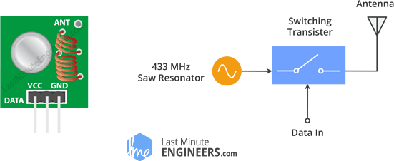
Transmitter
The heart of the module is the SAW resonator which is tuned for 433MHz operation.
There is a switching transistor and a few passive components.

Slide 3
Cont….
When a logic HIGH is applied to the DATA input, the oscillator runs producing a constant RF output carrier wave at 433MHz.
When the DATA input is taken to logic LOW, the oscillator stops. This technique is known as Amplitude Shift Keying.
In Amplitude Shift Keying the amplitude of the carrier is changed in response to the incoming data signal.

Slide 4
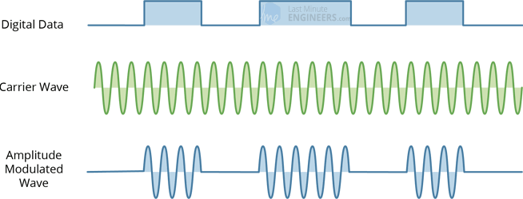
ASK
For Digital 1 – This drives the carrier at full strength.
For Digital 0– This cuts the carrier off completely.

Slide 5
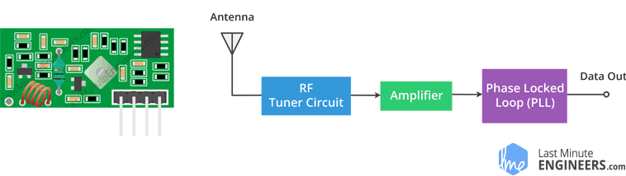
Receiver
It consists of a RF tuned circuit and a couple of OP Amps to amplify the received carrier wave from the transmitter.

